Slide 1
AI showdown
By Daniel Barragues

Slide 2
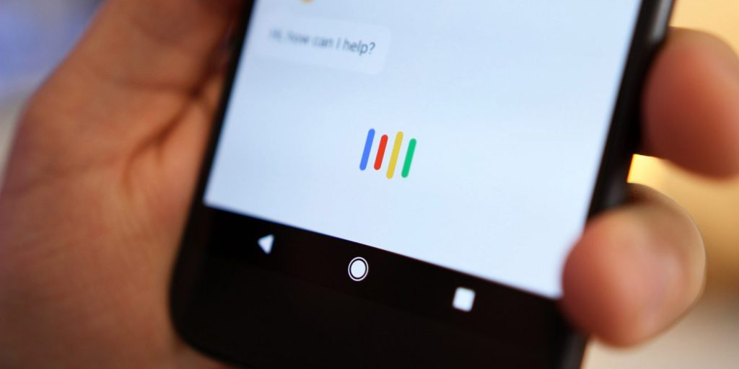
Google Assistant

Slide 3
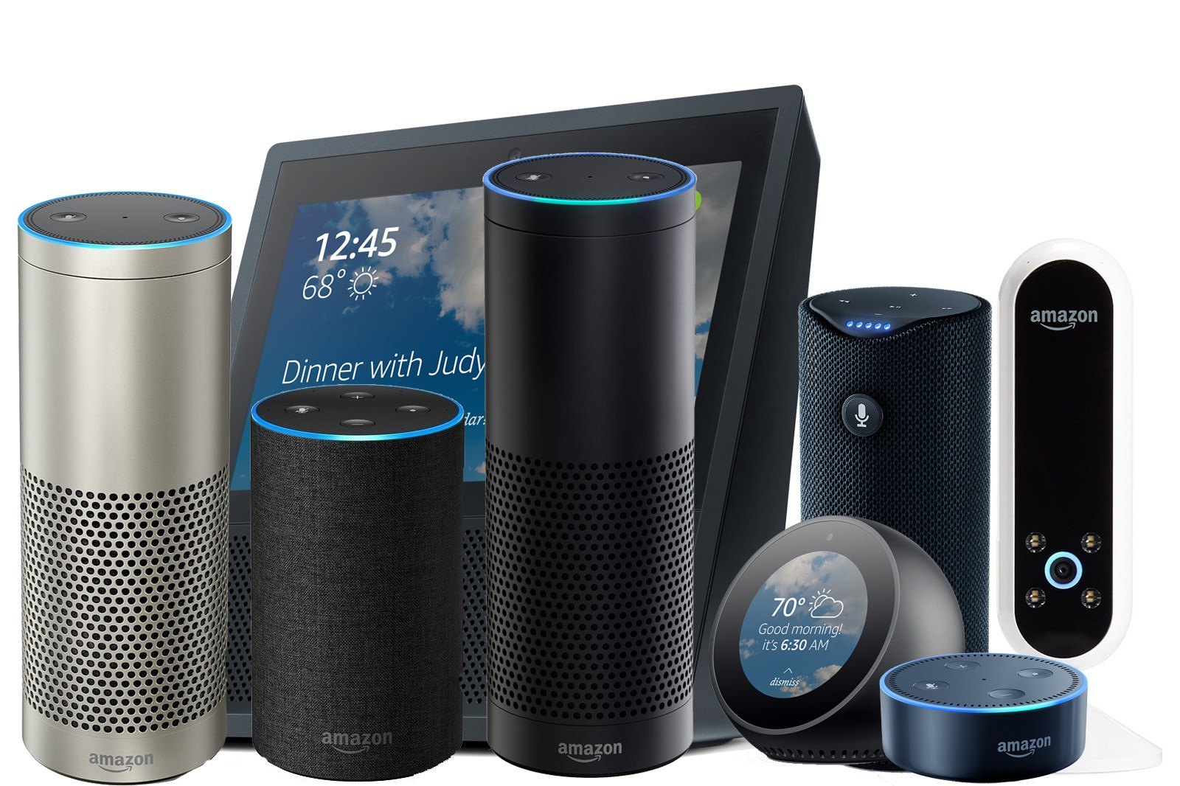
Amazon Alexa

Slide 4
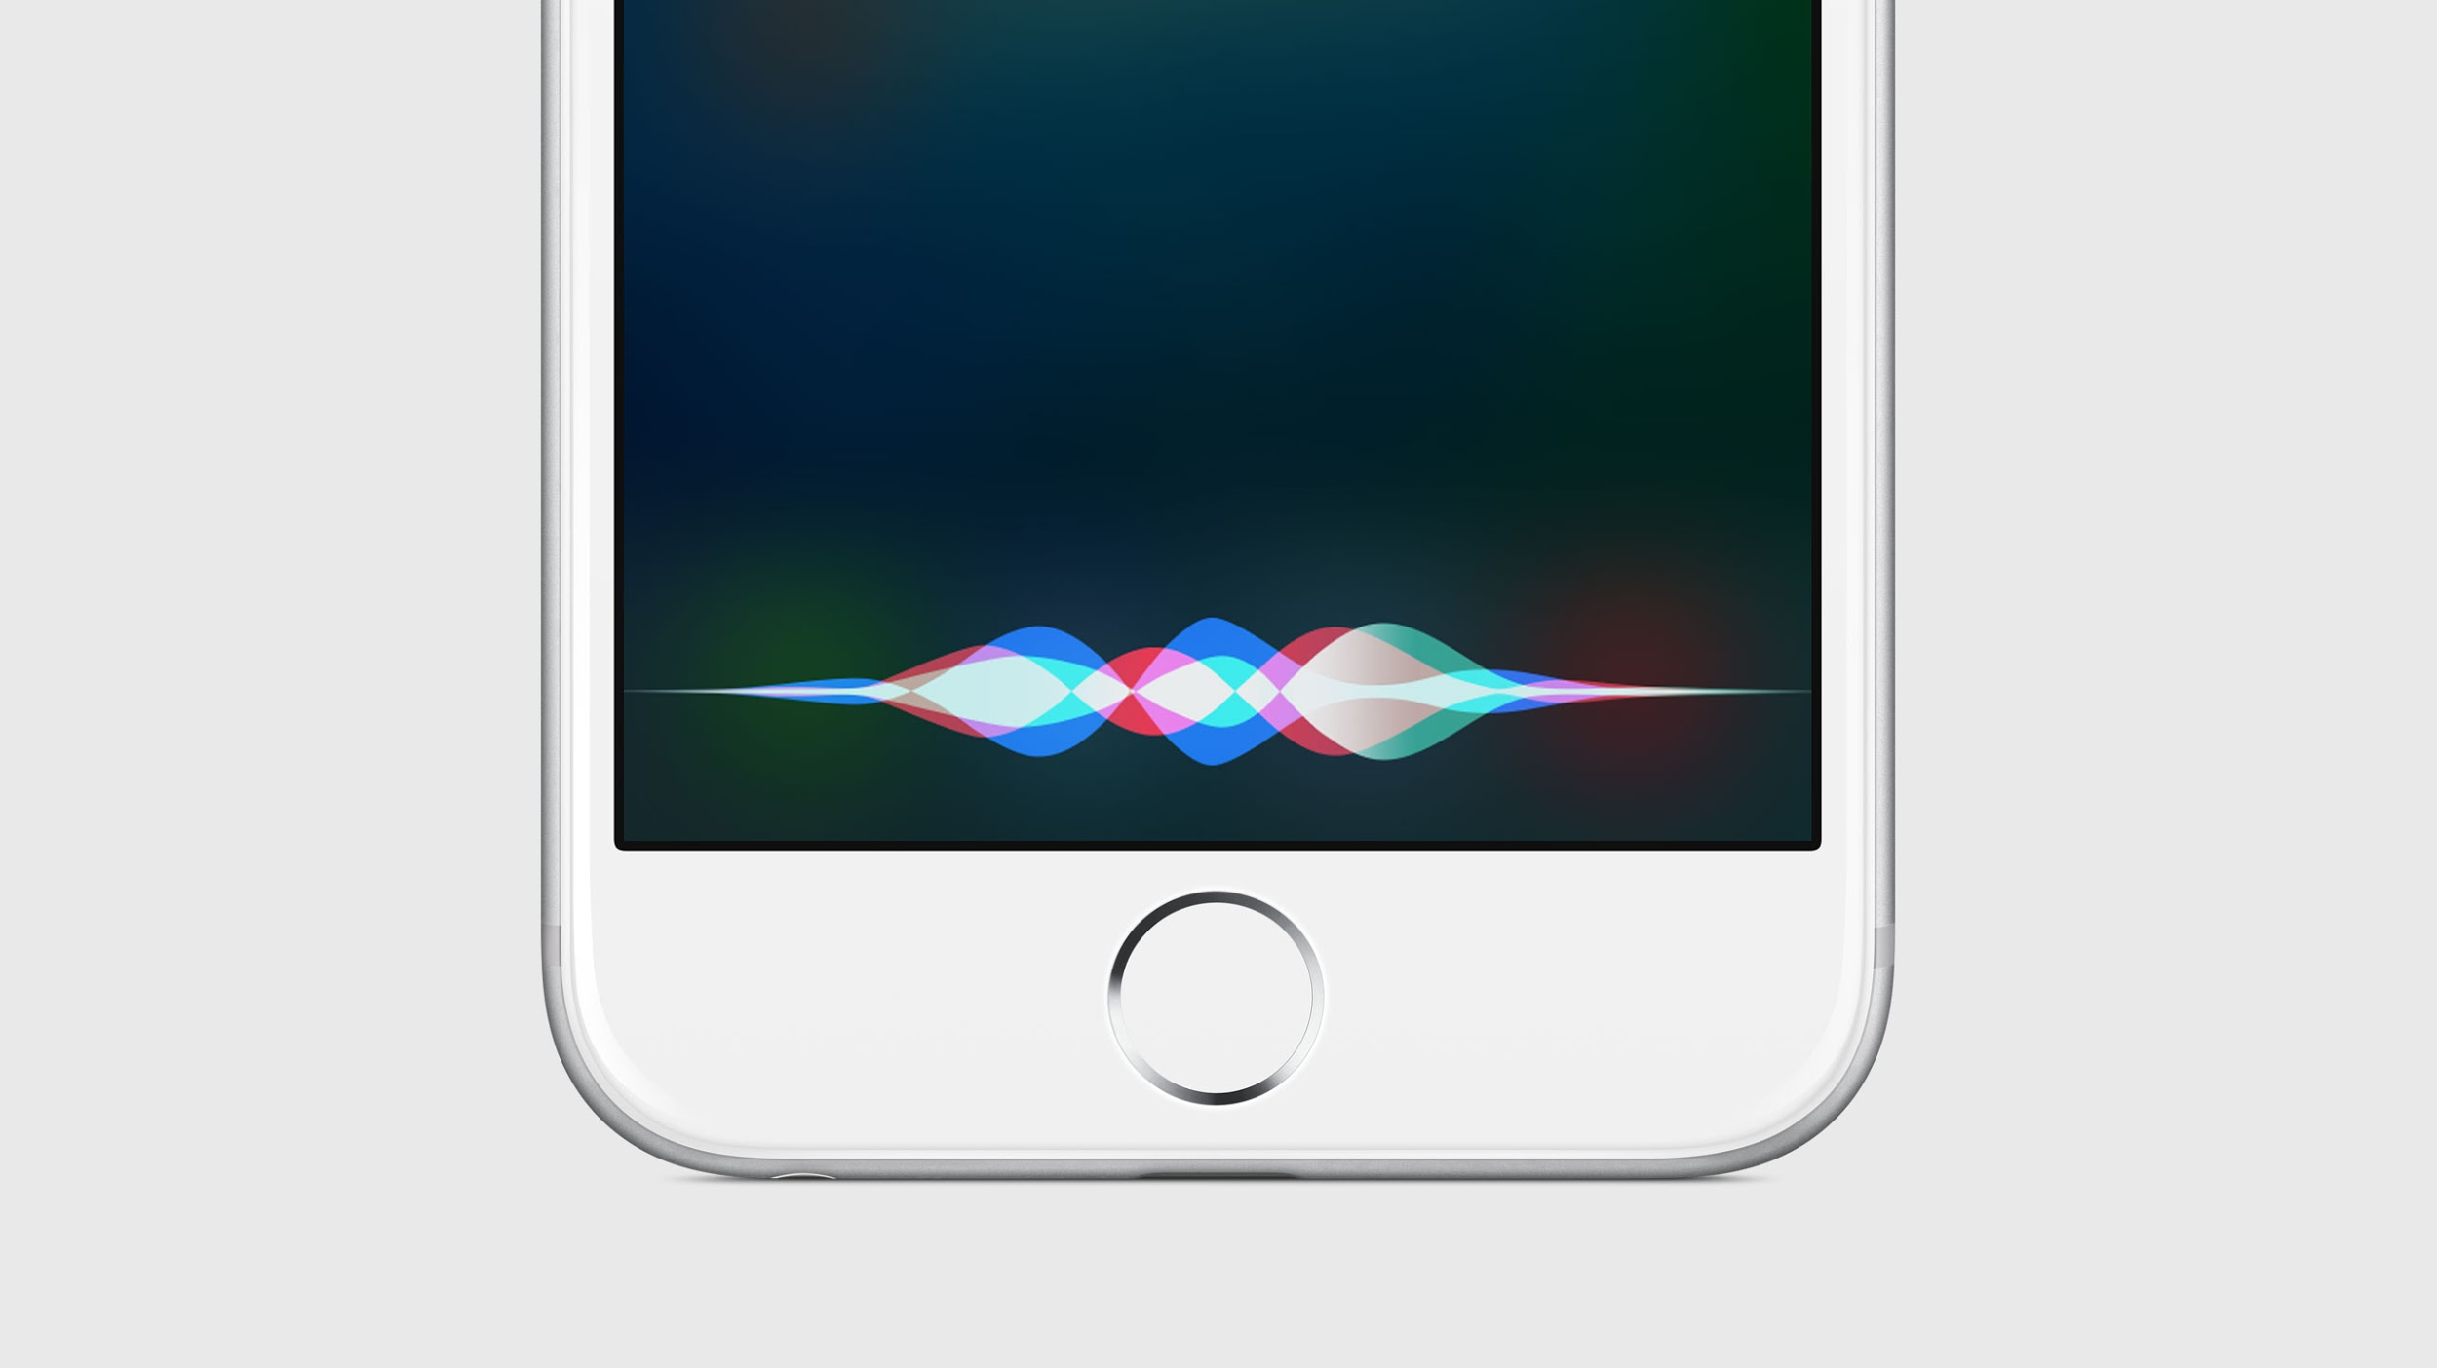
Siri

Slide 5
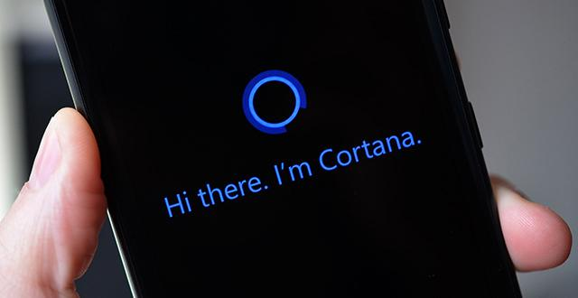
Cortana

Slide 6
Do we really need AI?
Companies want to integrate it in EVERYTHING
Invasive?
User improvement program or NSA improvement program?

